Slide 1

COMP 469
AI Agents
and Foundations
Week 1: define intelligence, build agent vocabulary, and prepare for the grid-world lab.
COMP 469 | CSU Channel Islands
01
Notes:
0:00-0:03. Welcome students and frame the lecture as the launch point for the course. The goal is not to memorize definitions, but to learn the agent lens that will organize the semester.

Slide 2
1.1 What Is AI?
AI is concerned with understanding AND building intelligent entities — machines that compute how to act effectively and safely
Already generating > $1 trillion/year in revenue (and growing rapidly)
Two central dimensions create four approaches:
Human vs. Rational (fidelity to humans vs. formal optimality)
Thought vs. Behavior (internal processes vs. external action)
The prevailing view: the Standard Model
AI focused on rational action aka “doing the right thing”
'Right thing' is defined by the objective provided to the agent
Shared with control theory, operations research, economics, statistics
Key refinement: perfect rationality is computationally intractable — limited rationality and value alignment are critical concerns

Slide 3
What is AI?
Is concerted with not just understanding but also building intelligent entities – machines that can
compute how to act effectively and safely in a wide variety of novel situations.
AI Expert – Kai-Fu Lee predicts that the impact will be “more than anything in the history of mankind”
AI is a universal field – Playing Chess, proving mathematical theorems, writing poetry, driving a car, or
Diagnosing deseases.

Slide 4
Syllabus alignment for Week 1
AI Agents and Foundations | Aug 24-28
Core concept
Reading focus
Lab focus
AI agents and foundations
AIMA Chapter 1 and Chapter 2; instructor notebook
Simple grid-world / vacuum agent simulation in Python
Course pattern
Short lecture segments introduce the vocabulary.
Guided demos turn vocabulary into executable code.
Labs emphasize implementation, testing, and explanation.
CI Learn is the source for announcements, notebooks, and submissions.
COMP 469 | AI Agents and Foundations
03
Notes:
0:06-0:10. Connect this slide to the syllabus. Mention that Weekday classes begin Aug 24 and that students should use CI Learn for the latest materials and due dates.

Slide 5
Learning outcomes for today
Students should leave ready to explain and implement a small agent.
1
Define intelligence
Explain human-centered vs. rational definitions of AI.
2
Model an agent
Describe percepts, sensors, actions, actuators, and environment.
3
Evaluate behavior
Use performance measures and expected outcomes.
4
Specify PEAS
Write a complete task-environment description.
5
Run a simulation
Implement a small grid-world loop in Python/Jupyter.
COMP 469 | AI Agents and Foundations
04
Notes:
0:10-0:13. This is the contract for the lecture. Tell students that these outcomes also predict what the lab asks them to submit.

Slide 6
Course tooling: get ready to compute
A minimal stack for the first lab and future assignments.
Python 3
Jupyter
NumPy
language
notebooks
arrays
pandas
scikit-learn
PyTorch / TensorFlow
data
models
later neural nets
Today’s rule: keep the first notebook small, inspectable, and easy to debug.
COMP 469 | AI Agents and Foundations
05
Notes:
0:13-0:18. Confirm students can open notebooks and know where files are posted. Emphasize that a GPU is not required for the course.

Slide 7
Responsible AI use in this course
Use AI tools to learn, not to outsource learning.
Allowed support
Not allowed
Ask conceptual questions, debug error messages, generate tiny examples, compare approaches.
Do not submit AI-generated code, text, analysis, diagrams, or results unless the assignment permits it and you disclose it.
Disclosure prompt
What tool did you use? What help did you request? What did you verify or change yourself?
COMP 469 | AI Agents and Foundations
06
Notes:
0:18-0:22. Ground this in the syllabus. Students may use AI agents for help, but they must understand and explain their own submissions.

Slide 8
What counts as intelligence?
Start with behavior we can observe and evaluate.
Think-pair-share
Perception
Action
What information enters the system?
What choices can it make?
Name one system you consider intelligent. What does it perceive? What does it do?
Objective
Adaptation
What makes one behavior better than another?
Does it learn or improve over time?
Use student examples to move from “smart” as a label to “agent” as an analysis tool.
COMP 469 | AI Agents and Foundations
07
Notes:
0:22-0:30. Give students 2 minutes to think, 2 minutes to pair, and take 3-4 examples. Translate each example into perception, action, objective, and adaptation.

Slide 9
Four historical approaches to AI
Human vs. rational; thought vs. behavior.
Thinking
Acting
Cognitive modeling
Turing test
Humanly
Does it think like a human?
Does it act like a human?
Laws of thought
Rational agents
Rationally
Does it reason correctly?
Does it act to achieve the best expected outcome?
COMP 469 uses the rational-agent view as the organizing model.
COMP 469 | AI Agents and Foundations
08
Notes:
0:30-0:37. Explain the matrix and why the rational-agent approach is useful for design and evaluation.

Slide 10
Why “acting rationally” is useful
It gives us a design target: choose actions that are expected to work.
General
Measurable
Buildable
Works for software, robots, games, classifiers, assistants, and decision systems.
Connects behavior to performance measures, evidence, and uncertainty.
Lets us derive programs from task descriptions instead of relying only on intuition.
But rationality depends on the objective we provide.
Poorly specified goals can produce technically “rational” behavior that no one actually wants.
COMP 469 | AI Agents and Foundations
09
Notes:
0:37-0:42. This prepares students for value alignment and performance measure pitfalls without going too deep yet.

Slide 11
Agent vocabulary
The same words will appear in lecture, lab, and exams.
sensors → percepts
actuators
Agent
Environment
Actions
Program + architecture that maps percepts to actions.
The part of the world relevant to the task.
Choices that affect the environment or gather information.
An agent is anything that perceives its environment through sensors and acts on it through actuators.
COMP 469 | AI Agents and Foundations
10
Notes:
0:42-0:48. Tie the agent loop directly to Chapter 2. Ask students to point to sensors and actuators in a phone, a robot vacuum, and a recommendation system.

Slide 12
Percepts, histories, and actions
The current percept is not always enough.
Percept
Percept sequence
Agent function
The content currently received by sensors.
The complete history of percepts so far.
A mapping from possible percept sequences to actions.
Example: braking from a video frame
A single frame may show red lights.
A short history can reveal whether lights just turned on.
Memory changes what the agent can infer.
COMP 469 | AI Agents and Foundations
11
Notes:
0:48-0:53. Students often confuse percept with state. Explain that the agent may not know the true state; it only receives percepts.

Slide 13
Agent function vs. agent program
One is an abstract behavior; the other is executable implementation.
Agent function
Agent program
Mathematical description: for every possible percept sequence, what action should be selected?
Concrete implementation: code running on hardware that receives the current percept and returns an action.
Why not just tabulate every possible percept sequence?
The table grows explosively. AI needs compact programs that produce rational behavior.
COMP 469 | AI Agents and Foundations
12
Notes:
0:53-0:58. Use the table-driven agent as a thought experiment. The point is not that tables are impossible in small examples; the point is that general intelligence needs compact structure.

Slide 14
Good behavior: performance measures
Rationality is judged by consequences relative to a measure.
Vacuum cleaner
Better measure
Lesson
Bad measure: reward dirt collected. The agent could dump dirt and clean it again.
Reward clean squares over time, possibly penalizing noise, energy, or movement.
Measure what you actually want achieved, not a convenient proxy.
Question for students
What could go wrong if an AI tutor is rewarded only for “minutes spent in app”?
COMP 469 | AI Agents and Foundations
13
Notes:
0:58-1:05. Have students identify proxy metrics and failure modes. This is a gentle introduction to objective specification and value alignment.

Slide 15
Rationality is not omniscience
A rational action can still lead to a bad outcome.
Omniscience
Rationality
Perfection
Knows the actual outcome of every action.
Chooses the action expected to maximize performance using available evidence.
Always gets the best actual outcome after the fact.
Expected performance matters because real agents act under uncertainty.
Rational agents should also gather information when information improves future choices.
COMP 469 | AI Agents and Foundations
14
Notes:
1:05-1:10. Use this to prevent hindsight bias. Make the phrase expected performance concrete.

Slide 16
Activity: rational or not?
Decide using the agent’s evidence, not hindsight.
Robot vacuum
Taxi
Email filter
Moves left when clean, but it may already be at the left wall.
Slows down before a blind corner even though no car appears.
Quarantines a message because it matches known phishing indicators.
For each case, identify:
What evidence did the agent have?
What performance measure is assumed?
What information would improve the next action?
COMP 469 | AI Agents and Foundations
15
Notes:
1:10-1:17. Small-group discussion. Ask each group to defend one judgment. Keep the focus on evidence and performance measures.

Slide 17
Five-minute reset
When you return, we will turn the agent idea into a task specification and then into Python code.
Next: PEAS → environment properties → lab notebook
COMP 469 | Break
16
Notes:
1:17-1:22. Break.

Slide 18
PEAS framework
Performance, Environment, Actuators, Sensors.
P
E
A
S
Performance
Environment
Actuators
Sensors
How success is measured
Where the agent operates
How the agent acts
How the agent perceives
In designing an agent, specify PEAS as fully as possible before choosing algorithms.
COMP 469 | AI Agents and Foundations
17
Notes:
1:22-1:27. Emphasize that PEAS is a design discipline. Students should not jump to code before specifying the task environment.

Slide 19
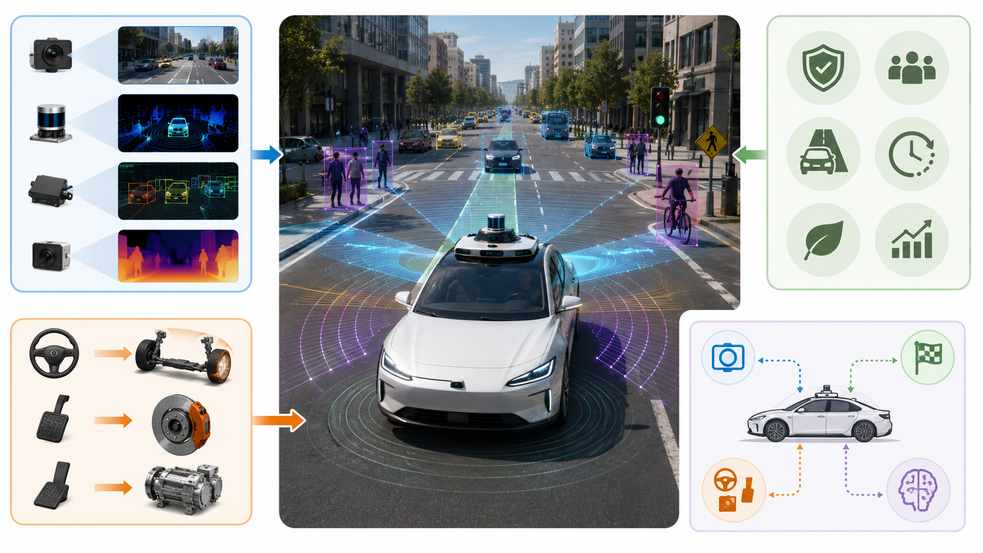
PEAS example: automated taxi
A complex agent shows why specification matters.
Performance
Environment
Safe, legal, comfortable, efficient, profitable trip.
Roads, vehicles, pedestrians, weather, passengers.
Actuators
Sensors
Steering, braking, accelerator, display, voice.
Cameras, lidar, speedometer, GPS, microphones.
Tradeoffs are unavoidable: speed vs. safety, cost vs. comfort, profit vs. passenger preference.
COMP 469 | AI Agents and Foundations
18
Notes:
1:27-1:34. Use the taxi to show that PEAS is not just a table; it exposes conflicting objectives and environment complexity.

Slide 20
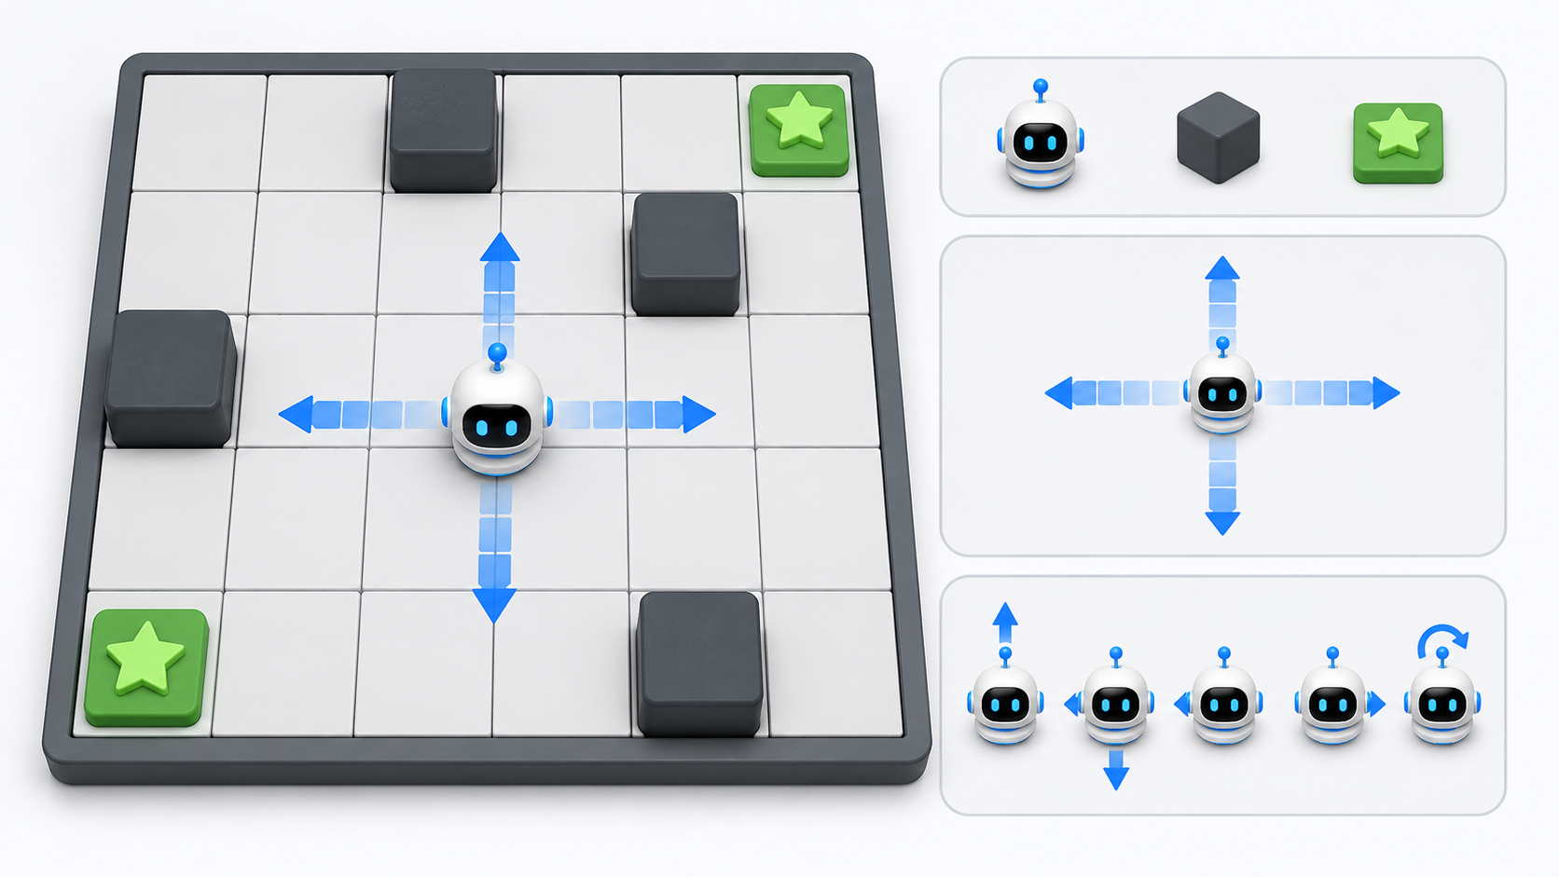
PEAS example: grid-world cleaner
The lab version is intentionally small but conceptually complete.
Performance
Environment
+1 for clean cells; penalties for movement or time.
Grid cells, walls, dirt, starting position, goal conditions.
Actuators
Sensors
Move north/south/east/west; clean current cell; stop.
Location sensor, dirt sensor, wall sensor, or partial observations.
Changing one PEAS element can make the same agent rational or irrational.
COMP 469 | AI Agents and Foundations
19
Notes:
1:34-1:40. This slide bridges to lab. Ask: what if the location sensor is removed? What if movement has a cost? What if dirt reappears?

Slide 21
Environment properties: what the agent is up against
These dimensions influence the right agent design.
Observable?
Single or multiagent?
Deterministic?
Sequential?
Can sensors access all relevant state?
Do other decision-makers affect performance?
Is the next state fully determined by current state and action?
Do current actions affect future choices?
Dynamic?
Continuous?
Known?
Can the world change while the agent deliberates?
Are state, time, percepts, or actions continuous?
Does the agent know the rules or transition probabilities?
Hardest case: partially observable, multiagent, nondeterministic, sequential, dynamic, continuous, and unknown.
COMP 469 | AI Agents and Foundations
20
Notes:
1:40-1:46. Give one quick example for each property. Avoid over-defining; the goal is to prepare students to classify the lab environment.

Slide 22
Classify three environments
Use the dimensions to explain design difficulty.
Crossword puzzle
Chess
Robot taxi
mostly observable, single-agent, static, discrete
observable, competitive multiagent, sequential, discrete
partially observable, multiagent, dynamic, continuous, uncertain
Prompt
Which one needs internal state? Which one needs planning? Which one needs uncertainty handling?
COMP 469 | AI Agents and Foundations
21
Notes:
1:46-1:52. Let students answer quickly. Reinforce that environment properties determine the appropriate agent architecture.

Slide 23
Agent program families
Four basic designs recur across AI systems.
Simple reflex
Model-based
Goal-based
Utility-based
Current percept → action
Current percept + internal state → action
Choose actions that achieve desired states
Choose actions that maximize expected utility
More expressive designs are usually more flexible, but often more computationally expensive.
COMP 469 | AI Agents and Foundations
22
Notes:
1:52-1:58. Present this as a progression of what information is represented explicitly. This sets up future weeks on search, planning, uncertainty, and learning.

Slide 24
Simple reflex agents
Condition-action rules are useful, but brittle.
Rule
Strength
Weakness
if current square is dirty then Suck
else move to another square
Small, fast, inspectable, easy to implement.
Fails under partial observability or changed performance measures.
Lab connection
Start with a simple reflex policy so the simulation loop is understandable before improving the agent.
COMP 469 | AI Agents and Foundations
23
Notes:
1:58-2:03 if extended; otherwise compress. If running exactly two hours, use this and the next several slides as lab support material after the main lecture.

Slide 25
Model-based agents
Internal state helps when sensors are incomplete.
Percept
Internal state
Model
Action
What I see now
Best guess of what the world is like now
How the world changes and how sensors reflect state
Decision using state estimate
Transition model + sensor model = a way to update beliefs about state.
COMP 469 | AI Agents and Foundations
24
Notes:
Use this when moving beyond simple reflex. If the grid-world agent cannot see all cells, it needs memory or a belief state.

Slide 26
Goal-based and utility-based agents
Planning and tradeoffs enter once “what do I want?” is explicit.
Goal-based
Utility-based
Select actions that reach a desirable state. Example: get to the goal tile.
Compare outcomes by degree of desirability. Example: reach goal while minimizing cost and risk.
Question
In a grid-world, is “reach goal” enough, or do we also care about path length, risk, and energy?
COMP 469 | AI Agents and Foundations
25
Notes:
Connect goal-based agents to search and planning in later weeks. Connect utility-based agents to uncertainty and tradeoffs.

Slide 27
Learning agents
Learning modifies components to improve performance from feedback.
Performance element
Learning element
Critic
Chooses actions
Improves the performance element
Provides feedback against a performance standard
Problem generator
Suggests exploratory actions
Today’s lab is not full learning yet; it sets up the simulation framework needed for learning later.
COMP 469 | AI Agents and Foundations
26
Notes:
Briefly introduce the learning agent architecture. Do not go deep; the goal is to show why simulation and performance measures matter.

Slide 28
Python/Jupyter review
We need just enough Python to implement the lab cleanly.
Functions
Dictionaries
Classes
Encapsulate environment logic: reset(), perceive(), step().
Represent state, rewards, and configuration.
Optional structure for Environment and Agent objects.
Loops
Randomness
Trace output
Run repeated percept → action → update cycles.
Test stochastic environments or randomized policies.
Print or log states before making plots.
COMP 469 | AI Agents and Foundations
27
Notes:
This is a quick diagnostic. Ask how many students have used notebooks and Python classes. Adjust lab pacing accordingly.

Slide 29
Notebook skeleton: the simulation loop
Keep the first implementation small and inspectable.
state = env.reset()
score = 0
for t in range(20):
percept = env.perceive(state)
action = agent.act(percept)
state, reward = env.step(action)
score += reward
print(t, percept, action, score)
Trace each step
What did the agent perceive?
Which action did it choose?
How did the environment change?
How did the score change?
Debug first. Optimize later.
COMP 469 | AI Agents and Foundations
28
Notes:
Walk through each line. Connect env.perceive and env.step to sensors and actuators. The print trace is the simplest debugging tool.

Slide 30
Grid-world lab: minimum viable environment
Define a world that is small enough to inspect by hand.
G
State
Actions
agent position, dirt locations, walls, time step
N, S, E, W, Clean, Stop
Reward
Terminal condition
+ clean cell, - movement, - invalid move, + goal
all dirt cleaned, goal reached, or max steps exceeded
Your first grid-world should be boring enough that bugs are obvious.
COMP 469 | AI Agents and Foundations
29
Notes:
Use this slide as the lab setup. Ask students to describe a state representation. Then ask what information the agent does and does not receive.

Slide 31
Lab deliverable
What students should submit or demonstrate.
1. PEAS table
2. Agent policy
3. Simulation trace
Performance, Environment, Actuators, Sensors for your grid-world.
At least one simple reflex policy implemented in code.
A printed trace showing percept, action, new state, and score.
4. Reflection
5. Extension
Explain when your agent is rational and when it fails.
Optional: add walls, stochastic dirt, or partial observability.
COMP 469 | AI Agents and Foundations
30
Notes:
Make deliverables concrete. A short trace and short reflection are more valuable than a large untested notebook.

Slide 32
Common bugs in first agent simulations
Most errors come from hidden assumptions.
State mutation
Coordinate confusion
Reward leakage
The environment changes a dictionary or list unexpectedly across steps.
Rows vs. columns or x vs. y are flipped.
The agent gets credit twice or misses penalties.
Invalid moves
No trace
Walking through walls or outside the grid changes state incorrectly.
The simulation only prints final score, making bugs hard to see.
COMP 469 | AI Agents and Foundations
31
Notes:
Use this to normalize debugging. Encourage students to print state and action at every time step until behavior is obvious.

Slide 33
In-class activity: design before coding
Choose one scenario and write PEAS + environment properties.
Campus delivery robot
Email triage agent
Grid-world cleaner
Deliver items between buildings without blocking pedestrians.
Prioritize incoming email without hiding important messages.
Clean cells efficiently with limited sensors.
Group output
One PEAS table
One environment classification
One agent design choice and why
COMP 469 | AI Agents and Foundations
32
Notes:
If time permits, use this activity near the end. Otherwise assign it as a short in-class check or Canvas discussion prompt.

Slide 34
Exit ticket
Five minutes: make the agent lens stick.
Question 1
Question 2
Question 3
What is one AI system you can describe using PEAS?
What performance measure could cause that system to behave badly?
What is one environment property that makes the task difficult?
Submit as a short response or discuss before leaving.
COMP 469 | AI Agents and Foundations
33
Notes:
Use as the last five minutes. This gives you a quick diagnostic of whether students understand PEAS, performance measures, and environment properties.

Slide 35
Wrap-up: what to remember
This week’s foundation will recur throughout the course.
1
AI as agent design
Systems perceive, decide, and act in environments.
2
Rationality
Choose actions that maximize expected performance given evidence.
3
PEAS first
Specify tasks before selecting algorithms or writing code.
4
Environment matters
Observability, uncertainty, time, and other agents shape the design.
5
Simulation mindset
Use small worlds to test assumptions before scaling up.
Before next class: read AIMA Ch. 1-2 and open the instructor notebook.
COMP 469 | AI Agents and Foundations
34
Notes:
Final summary. Remind students where to find the notebook and what to prepare.

Slide 36
Source and instructor preparation notes
Keep or hide this backup slide.
Primary materials
Course syllabus: COMP 469 Artificial Intelligence/Neural Nets, Fall 2026.
AIMA Chapter 1: Introduction.
AIMA Chapter 2: Intelligent Agents.
Instructor notebook: grid-world / vacuum agent simulation.
Recommended prep
Open Jupyter before class and test the starter notebook.
Have one completed trace ready in case the live demo fails.
Decide whether the lab is individual, pairs, or small groups.
COMP 469 | AI Agents and Foundations
35
Notes:
Backup/reference slide. Hide it before presenting if you prefer.

